Slide 1
Traditional Manufacturing Processes
Casting
Forming
Sheet metal processing
Powder- and Ceramics Processing
Plastics processing
Cutting
Joining
Surface treatment

Slide 2
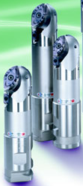
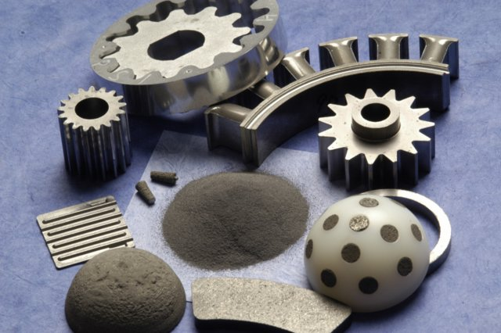
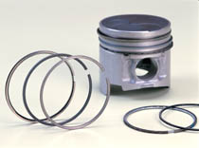
Powder Metallurgy, Manufacturing with Ceramics
Fine powder (plastic, ceramic, metal)
Shape by compacting in a die
Join powder particles (heat to just below melting point)
balls used in ball-point pens
gears, cams
cutting tools (inserts)
porous metal filters
oil-impregnated bearings
piston rings in engines

Slide 3
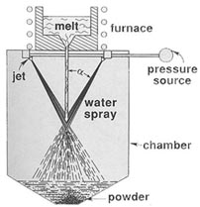
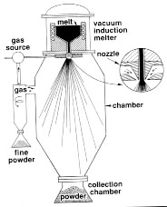
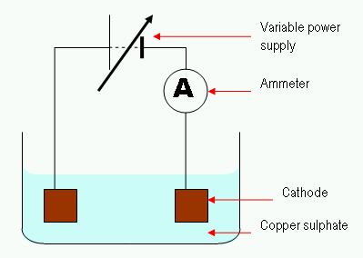
P-M: (1) Powder Production
Atomization: Spray liquid metal using high-pressure water, inert gas
water atomizer
air atomizer
Chemical method: Pass CO or H₂ gas over powdered Metal oxide (reduction)
Electrochemical action: Solution of metal salt →
Current →
Metal deposits on cathode

Slide 4
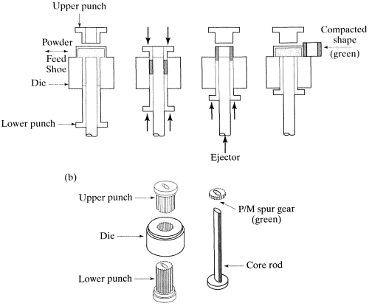
P-M: (2) Powder Blending, (3) Powder Compaction
Blending
  Mix different sizes of powder homogeneously
  Add lubricant to improve compaction die life
Compaction: produces green mold

Slide 5
P-M: (4) Sintering, (5) Finishing
Sintering:
Green compact → heated in oven to 70% ~ 90% of melting point → Diffusion weld
3-stage Sintering furnace: burn off lubricant → sinter → cool down
Finishing:
Coining and sizing: forging die to improve dimensional accuracy
Impregnation: e.g. oil impregnation for self-lubrication bearings
Infiltration: e.g. brazing of steel powders to add strength

Slide 6
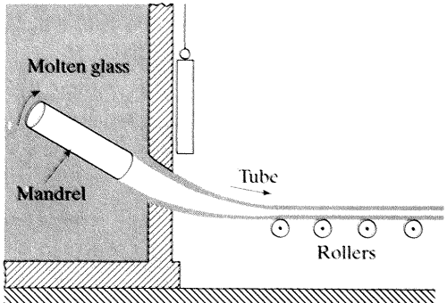
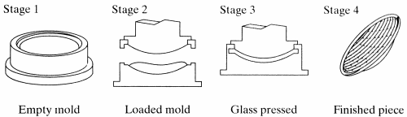
Manufacturing with Glass (and Ceramics)
Glass Sheet making: Rolling operation using molten glass
Glass tubes and rods: Drawing process using molten glass
Lenses, Headlamps manufacture: Molding process

Slide 7
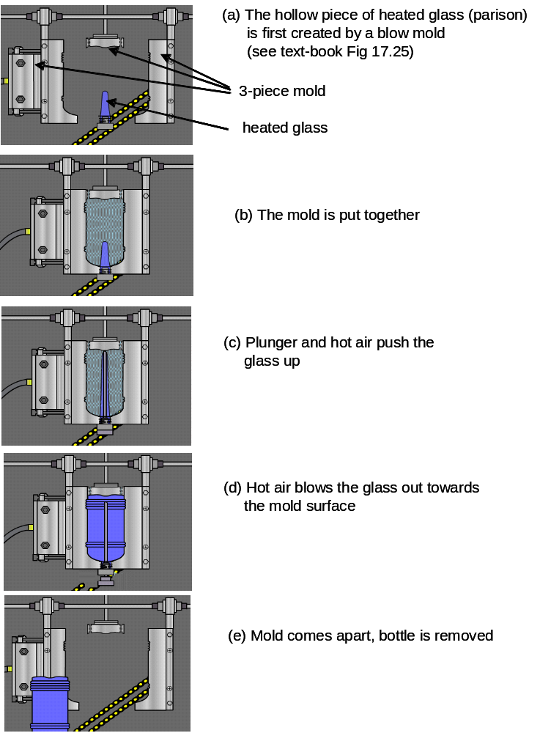
Bottle manufacture
Blow molding
source: http://www.pct.edu/prep/bm.htm

Slide 8
Traditional Manufacturing Processes
Casting
Forming
Sheet metal processing
Powder- and Ceramics Processing
Plastics processing
Cutting
Joining
Surface treatment

Slide 9
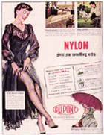
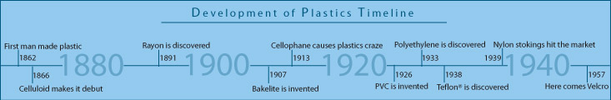
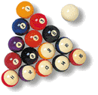
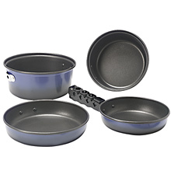
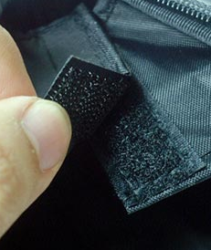

Plastics History

Slide 10
Plastic types: Thermosets
General properties: more durable, harder, tough, light.
Typical uses: automobile parts, construction materials.
Examples:
Unsaturated Polyesters: lacquers, varnishes, boat hulls, furniture
Epoxies and Resins: glues, coating of electrical circuits,
composites: fiberglass in helicopter blades, boats, …

Slide 11
Plastic types: Elastomers
General properties: these are thermosets, and have rubber-like properties.
Typical uses: medical masks, gloves, rubber-substitutes
Examples:
Polyurethanes: mattress, cushion, insulation, toys
Silicones: surgical gloves, oxygen masks in medical applications
joint seals

Slide 12
Plastic types: Thermoplastics
General properties: low melting point, softer, flexible.
Typical uses: bottles, food wrappers, toys, …
Examples:
Polyethylene: packaging, electrical insulation, milk and water bottles, packaging film
Polypropylene: carpet fibers, automotive bumpers, microwave containers, prosthetics
Polyvinyl chloride (PVC): electrical cables cover, credit cards, car instrument panels
Polystyrene: disposable spoons, forks, Styrofoam™
Acrylics (PMMA: polymethyl methacrylate): paints, fake fur, plexiglass
Polyamide (nylon): textiles and fabrics, gears, bushing and washers, bearings
PET (polyethylene terephthalate): bottles for acidic foods like juices, food trays
PTFE (polytetrafluoroethylene): non-stick coating, Gore-Tex™ (raincoats), dental floss

Slide 13
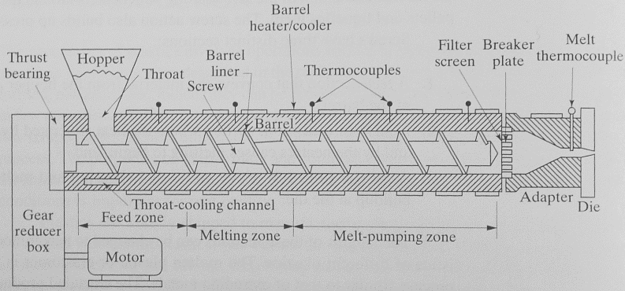
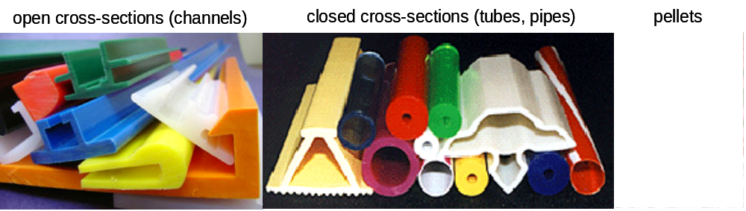
Plastics Processing: Extrusion

Slide 14
Plastics Processing: Blow molding
- similar to glass blow-molding -

Slide 15
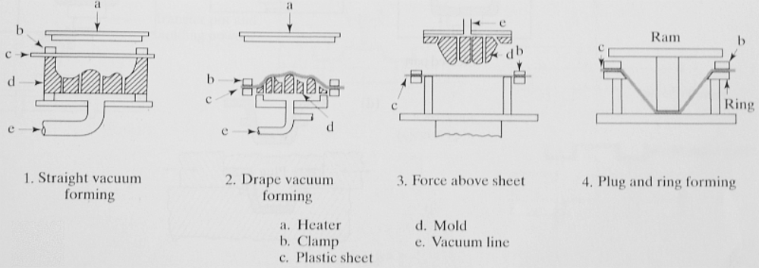
Plastics Processing: Thermoforming
Sheet of plastic → Heated (soft) → Molded using a shaped die

Slide 16
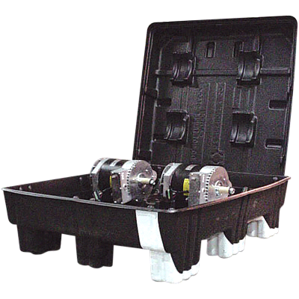
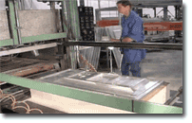
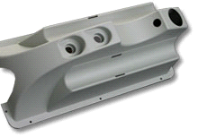
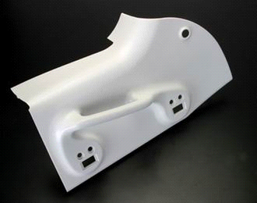
Vacuum thermoforming

Slide 17
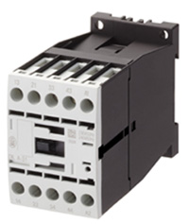
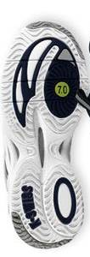
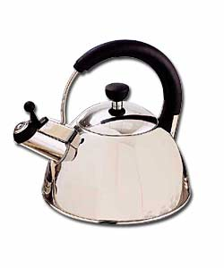

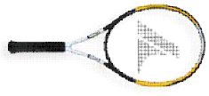
Plastics Processing: Compression and Transfer Molding
used mostly for thermosetting polymers
mold is heated and closed using pressure
plastic flows to fills the cavity
flash must be trimmed by finishing
dishes, handles for cooking pots
skis, housing for high-voltage switches
some rubber parts like shoe soles
and even composites such as fiber-reinforced parts

Slide 18
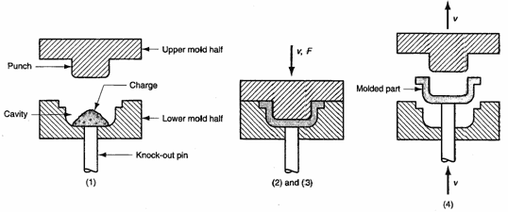
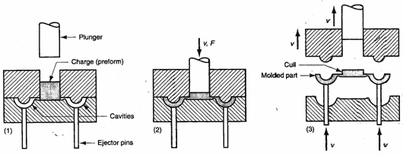
Plastics Processing: Compression and Transfer Molding
compression molding
transfer molding
(more complex shapes)

Slide 19
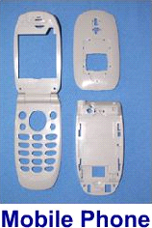
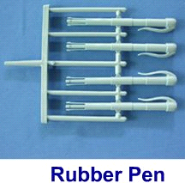

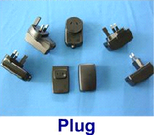
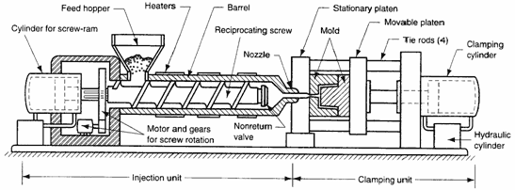
Plastics Processing: Injection Molding
- Probably the most common, most important, most economical process

Slide 20
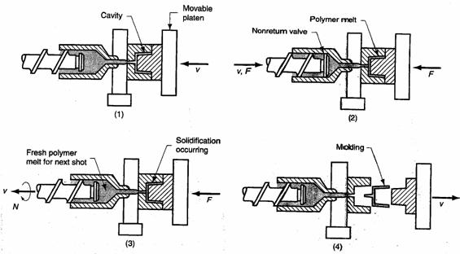
Plastics Processing: Injection Molding
Cycle of operation for injection molding
AVI [source: ylmf.com.hk]
[source: www.offshoresolutions.com]

Slide 21
Injection Molding: geometry of the mold
Basic components:
mold pieces (define the geometry of the part), AND
sprue, gates, runners, vents, ejection pins, cooling system

Slide 22
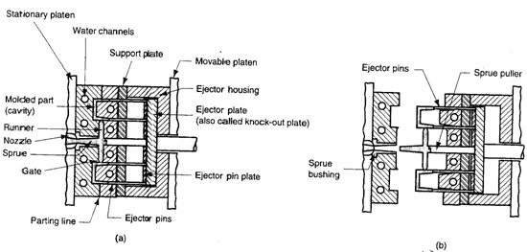
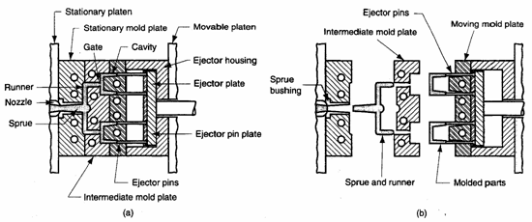
Injection Molding: 2-piece and 3-piece molds

Slide 23
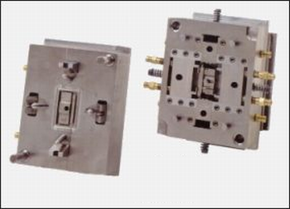
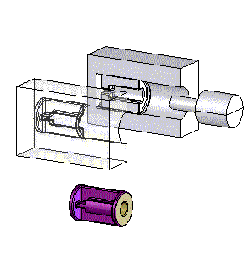
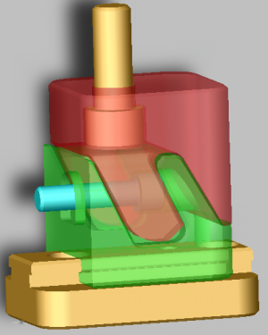
Injection Molding: molds with moving cores and side-action cams
- If the geometry of the part has undercuts [definition ?]

Slide 24
Injection Molding: designing injection molds
1. molding directions → number of inserts/cams required, if any
2. parting lines
3. parting planes → by extending the parting line outwards
4. gating design → where to locate the gate(s) ?
5. multiple cavity mold → fix relative positions of the multiple parts
6. runners: flow of plastic into the cavity
7. sprue located:
8. functional parts of the mold
- ejection system: to eject the molded part
- systems to eject the solidified runners
- alignment rods: to keep all mold components aligned

Slide 25
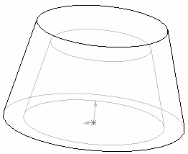
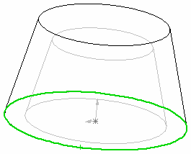
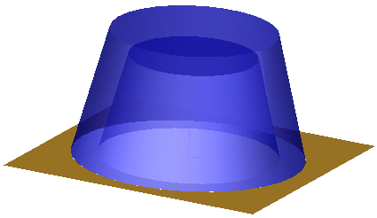
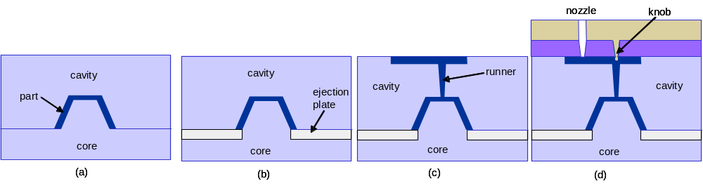
Injection Molding: designing injection molds
1. molding directions → number of inserts/cams required, if any
2. parting lines
3. parting planes → by extending the parting line outwards
4. gating design → where to locate the gate(s) ?
5. multiple cavity mold → fix relative positions of the multiple parts
6. runners: flow of plastic into the cavity
7. sprue located:
8. functional parts of the mold
- ejection system: to eject the molded part
- systems to eject the solidified runners
- alignment rods: to keep all mold components aligned
cup
parting line
gate
parting plane

Slide 26
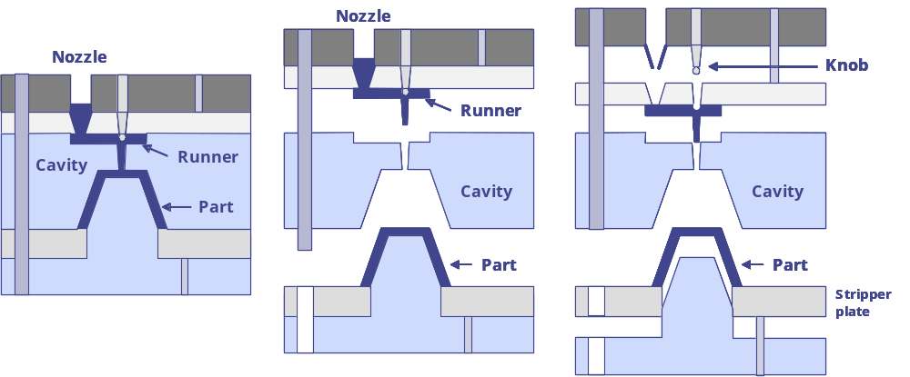
Designing injection molds: mold in action
[source: Lec notes, Prof T. Gutosky, MIT]

Slide 27
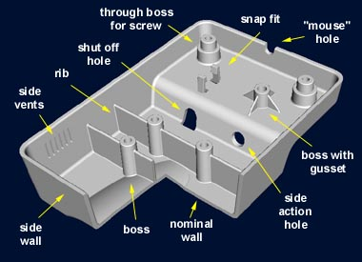
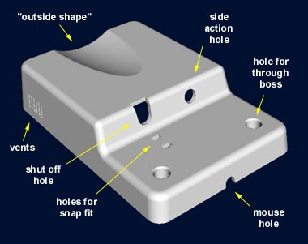
Designing injection molds: typical features
[source: www.idsa-mp.org]

Slide 28
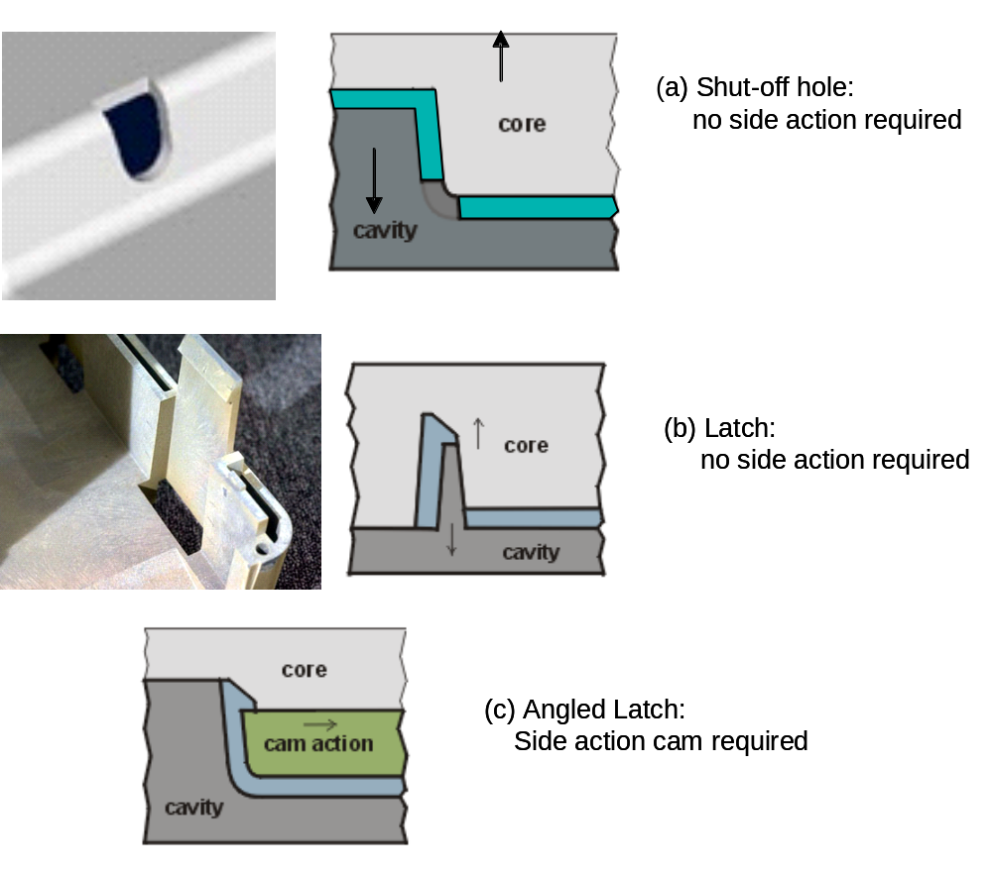
Designing injection molds: typical features

Slide 29
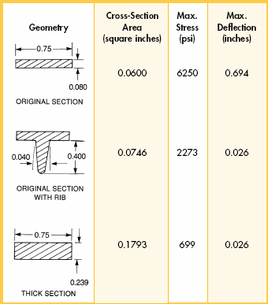
Considerations in design of injection molded parts
The two biggest geometric concerns
(i) proper flow of plastic to all parts of the mold cavity before solidification
(ii) shrinking of the plastic resulting in sink holes
Guideline (1)
maintain uniform cross-section thickness throughout the part
How: use of ribs/gussets
[source: GE plastics: Injection Molding Design Guidelines]

Slide 30
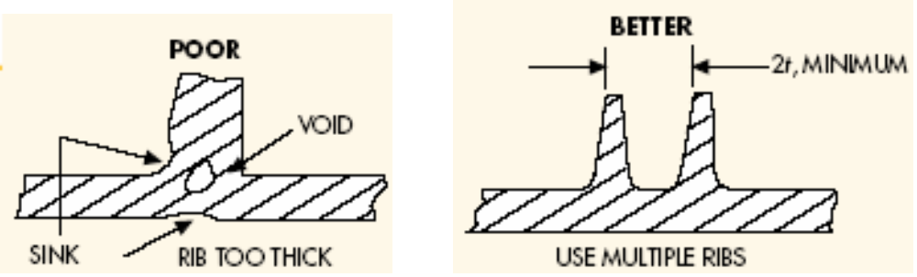
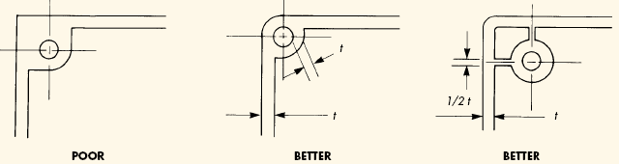
Considerations in design of injection molded parts
Guideline (2)
avoid thick cross-sections
[source: GE plastics: Injection Molding Design Guidelines]

Slide 31
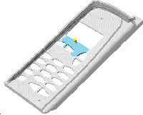

Considerations in design of injection molded parts
Guideline (3)
gate location determines weld lines
weld lines
* Source: http://www.idsa-mp.org/proc/plastic/injection/injection_design_7.htm

Slide 32
A Typical Plastics Molding Factory
- Tooling plant (produces and tests the injection mold)
- Molding plant (uses the mold to produce parts, assembles products, …)
Website: http://www.ylmf.com.hk

Slide 33
Summary
Topics covered: Powder metallurgy and Plastics processing
Further reading: Chapters 17, 19, Kalpakjian & Schmid

